Slide 1

ANPR & ATCC For Smart Traffic Management
AI-Supported Traffic Intelligence and Automated Monitoring Systems
Guided by: Ms. Mousami Shrivastava
Internship Program: Infosys Springboard

Slide 2

Introduction to Smart Traffic Management
Modern cities grapple with significant traffic issues, including congestion, violations, and accidents, compounded by inefficient manual monitoring.
Traditional traffic supervision methods are often slow, prone to human error, and lack the scalability required for urban growth.
To address these challenges, there's a critical need for advanced automated systems capable of:
Accurately identifying vehicles
Continuously monitoring traffic flow
Collecting high-quality traffic analytics
Supporting effective enforcement and urban planning
This project introduces a combined ANPR (Automatic Number Plate Recognition) and ATCC (Automatic Traffic Counter & Classifier) system, designed to meet these evolving demands for smarter city infrastructure.

Slide 3
The Challenge: Limitations of Current Traffic Monitoring
Inefficient Manual Monitoring
Limited CCTV Capabilities
Rapid growth in vehicle density has rendered traditional manual traffic monitoring methods largely inefficient and unsustainable.
Existing CCTV systems offer raw video footage but lack automated analytical capabilities, requiring extensive manual review.
Time-Consuming Violation Identification
Absence of Automation
Identifying vehicles involved in traffic violations or incidents currently relies on manual review, a process that is both slow and prone to errors.
Current systems frequently lack automated license plate recognition, vehicle classification, and comprehensive traffic counting and analytics features.
There is an urgent need for a real-time intelligent system that can automatically detect vehicles, recognize number plates, and analyze complex traffic patterns with precision.

Slide 4

Project Objectives: Enhancing Urban Mobility
Automated Vehicle Detection
Develop algorithms to reliably detect and track vehicles on roadways under various conditions.
Accurate Number Plate Recognition
Implement robust ANPR technology to extract and interpret license plate information with high accuracy.
Comprehensive Vehicle Classification
Categorize vehicles into distinct types (e.g., cars, motorcycles, buses, trucks) for detailed traffic analysis.
Traffic Flow Analysis & Counting
Accurately count vehicles and analyze traffic patterns to support urban planning and congestion management.
Integrated ANPR & ATCC Workflow
Construct a seamless workflow demonstrating the synergistic operation of ANPR and ATCC systems for holistic traffic intelligence.

Slide 5




Project Overview: A Unified Traffic Monitoring Solution
This project merges ANPR and ATCC technologies into a single, intelligent system, providing a robust solution for comprehensive traffic management.
Vehicle Detection
License Plate Recognition
Utilizes advanced object detection algorithms to accurately identify vehicles from video or image inputs.
Extracts and recognizes license plates using Optical Character Recognition (OCR) technology for identification.
Vehicle Classification
Traffic Counting & Statistics
Classifies detected vehicles into predefined categories such as cars, bikes, buses, and trucks.
Counts vehicles and generates vital traffic statistics to inform planning and operational decisions.
All processed data is visualized through an intuitive dashboard, presenting real-time traffic trends, vehicle distributions, and recognition results. This scalable and automated solution is designed for efficient real-time traffic surveillance.

Slide 6
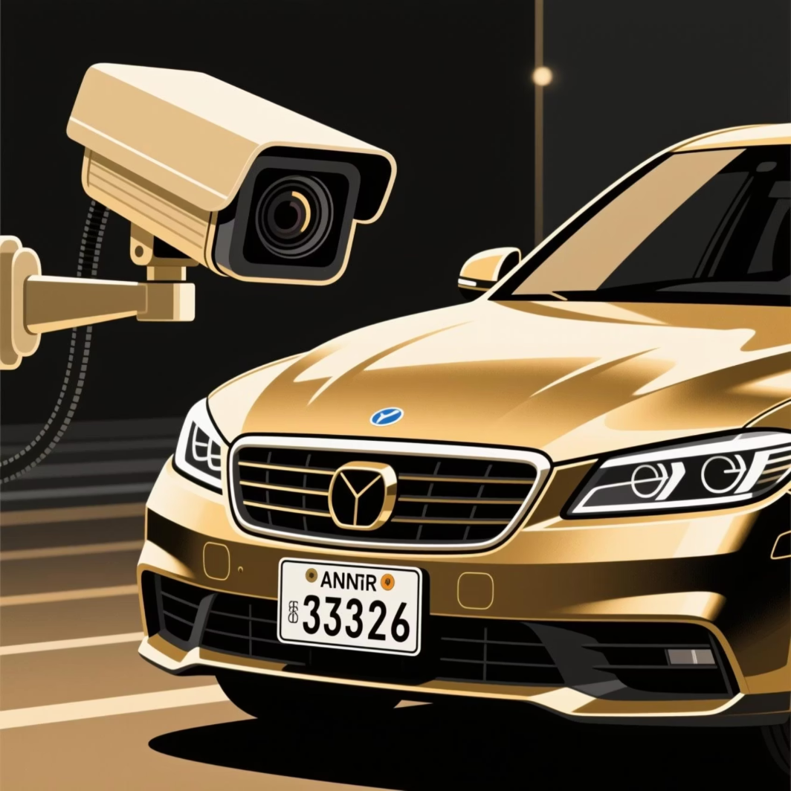
Robust Dataset for Training and Validation
Dataset 1: ANPR Dataset
Comprises images of vehicles with clearly visible number plates.
Features diverse lighting conditions and viewing angles for comprehensive training.
Primarily used for training and validating license plate detection and OCR accuracy.
Dataset 2: ATCC Vehicle Dataset
Consists of labelled images showcasing multiple vehicle classes.
Includes various categories such as cars, motorcycles, buses, and trucks.
Utilized for developing vehicle detection, classification, and counting functionalities.
Data Preprocessing Steps:
Frame extraction from videos.
Resizing and normalization of images.
Manual annotation for bounding boxes.
Noise reduction and image sharpening to enhance OCR accuracy.

Slide 7

ANPR: Automatic Number Plate Recognition
ANPR (Automatic Number Plate Recognition) is a sophisticated technology engineered to identify vehicles by automatically reading their unique license plates.
01
Capture & Detect
Captures an image of the vehicle and identifies the specific region containing the number plate.
02
Extract Plate Area
Isolates and extracts the number plate image from the broader vehicle image.
03
Recognize & Convert
Applies OCR (Optical Character Recognition) to convert the visual plate text into machine-readable characters.
04
Output Vehicle Number
Delivers the recognized license plate number, enabling automated vehicle identification.

Slide 8
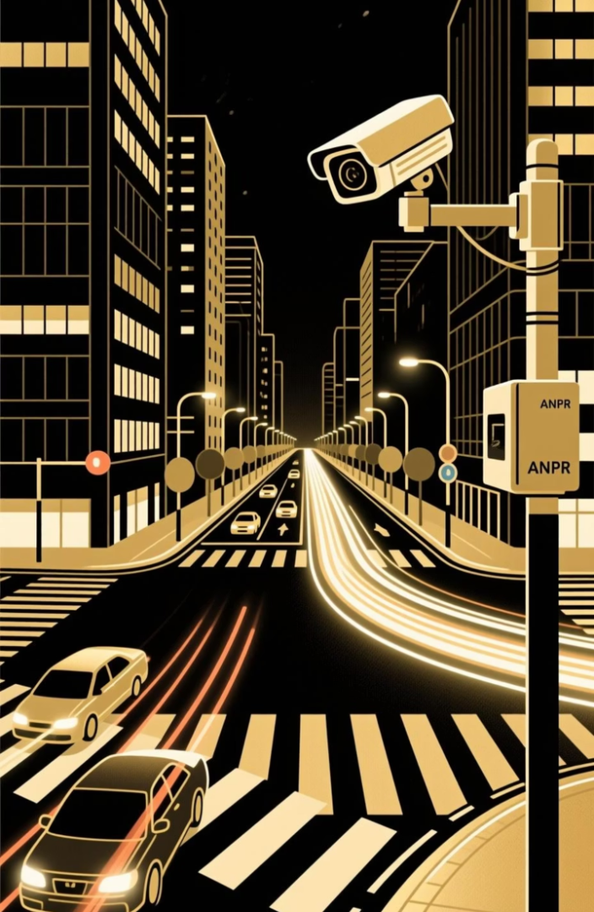




ATCC: Automatic Traffic Counter & Classifier
Detect Vehicles
Employs advanced sensors and AI to detect all vehicles present on the road.
Classify Vehicles
Automatically categorizes vehicles into types like cars, buses, trucks, and motorcycles.
Count Each Category
Key Applications of ATCC:
Maintains precise counts for each vehicle class, offering granular data.
Optimizing traffic signal timings to reduce wait times.
Informing urban planning for new infrastructure like roads and flyovers.
Analyze Traffic Patterns
Predicting and mitigating traffic congestion during peak hours.
Analyzes real-time data to assess traffic density, identify congestion points, and predict trends.
Enhancing road safety through proactive monitoring and data-driven decisions.

Slide 9








ANPR Architecture & Workflow
The ANPR system operates through a streamlined, multi-stage process to ensure accurate and timely vehicle identification.
Capture
Preprocess
High-resolution cameras capture images or video streams of vehicles.
Images are optimized through noise reduction and sharpening for better clarity.
Recognize
Integrate
Advanced algorithms extract and convert license plate characters using OCR.
Recognized data is stored in a central database for real-time analysis and reporting.
This seamless workflow ensures that accurate vehicle information is available for various traffic management applications, from enforcement to urban planning.

Slide 10


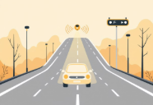





ATCC Architecture & Workflow
The ATCC system operates through a streamlined, multi-stage process to ensure accurate vehicle detection, classification, and counting.
Detect
Classify
Advanced sensors and AI algorithms detect all vehicles present on the road in real-time.
Vehicles are automatically categorized into types such as cars, buses, trucks, and motorcycles.
Count
Analyze
Precise counts are maintained for each vehicle class, providing granular traffic data.
Real-time data is analyzed to assess traffic density, identify congestion points, and predict trends.

Slide 11
Conclusion & Future Scope
Conclusion
The integrated ANPR and ATCC solution significantly advances intelligent traffic management by providing real-time data for dynamic control and strategic planning. This system reduces congestion, optimizes commute times, improves emergency response, and enhances road safety, empowering cities to make data-driven decisions for sustainable urban development.
Future Scope
Cloud Integration
Multi-Camera Coordination
Advanced AI Models
For scalable data management.
Enhancing coverage and accuracy.
Smarter prediction and optimization.
IoT Integration
Predictive Analytics
Broader data for deeper insights.
Proactive traffic management.

Slide 12
THANK YOU

